Slide 1
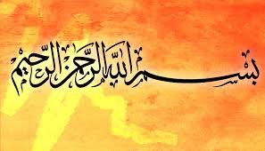
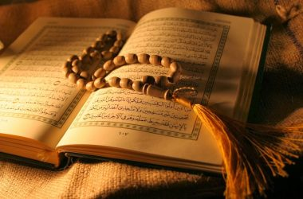
EDUCATION SYSTEM OF ISLAM

Slide 2
THE SUB-TOPICS
DEFINATION OF EDUCATION IN ISLAM
SIGNIFICANCE ACCORDING TO HOLY QURAN
SIGNIFICANCE ACCORDING TO HOLY PROPHET(P.B.U.H)
COMPONENTS OF ISLAMIC EDUCATION
THE ROLE OF MOSQUE
IMPORTANCE OF GIRLS EDUCATION
AIMS AND OBJECTIVES
CONCLUSION

Slide 3
DEFINATION OF EDUCATION IN ISLAM
In Islam EDUCATION is a combination of the terms “TARBIYYAH”, “TA’LIM” and “TA’DIB.”
TARBIYYAH means ‘EDUCATE’
TA’LIM means ‘KNOWLEDGEABLE’
TA’DIB derived from the word ‘ADABA’ means ‘MORAL’
The terms generally concerned with relationship of:
ALLAH Almighty
Human and their society

Slide 4
SIGNIFICANCE OF EDUCATION IN QURAN
The first verse of ‘QURAN’(surah alaq) indicates the importance of knowledge.
“Recite in the name of your ALLAH who created .
Created man from a clot of blood.
Recite, and your ALLAH is the most Generous .
Who taught by the pen.
Taught man that which he knew not.”
ALLAH Almighty created humanity and commanded to seek knowledge.
The significance of education is mentioned directly and indirectly in the Holy QURAN.
The Holy QURAN treats knowledge as a means of reaching IMAAN (FAITH) for all muslims.
In the Holy QURAN ALLAH SAYS:
“ALLAH grants wisdom to whom he pleases and to whom wisdom is granted indeed he receives an overflowing benefit.”

Slide 5
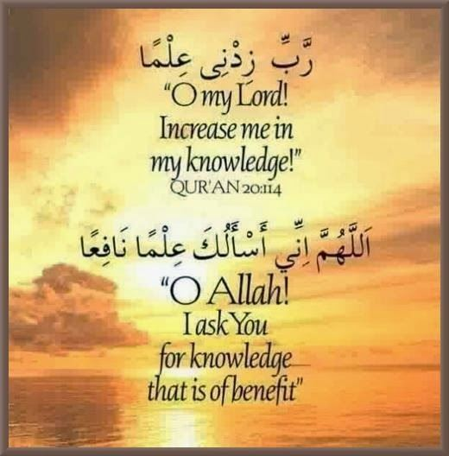
SIGNIFICANCE ACCORDING TO HOLY PROPHET(P.B.U.H)
The Holy Prophet(P.B.U.H) following hadiths
shows the importance of seeking knowledge
“Attainment of knowledge is must for every Muslim”
The Prophet S.A.W said:
“I am sent as teacher”
He further said:
“The superiority of a learned man over a worshipper is
like the superiority of moon over the stars”
And
“If a man seeks the path of acquiring knowledge,
ALLAH guides him to a path leading to paradise.”

Slide 6
COMPONENTS OF ISLAMIC EDUCATION
These are the main component of Islamic Education
QURANIC INTERPRETATION (TAFSIR)
PROPHET’S SAYING AND PRACTICES (HADITH)
Statements related to the prophet S.A.W
Implementation of Prophet S.A.W
ISLAMIC BELIEF (AQAID)
To believe that ALLAH is the one and only creator
To believe on the prophets To believe on Angels
To believe on the Holy Books To believe on the day of judgment
ISLAMIC MANNERS AND VALUES
Brotherhood
Equality

Slide 7
THE ROLE OF MOSQUE
The mosque play an important part in the spread of education in the Islamic world.
Mosque was the center of Muslim community
Mosque is the place for prayer , meditation, religious instructions, political discussion and a school
The first school connected to mosque was set up at MADINA in 653
The first educational institution in the Muslim world was the mosque.
built at Medina early in the seventh century by the Prophet Muhammad and his Companions.
mosques were used for teaching purposes, especially for the teaching of law and theology

Slide 8
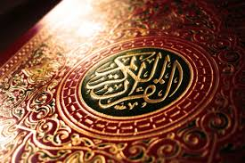
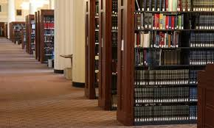
THE ROLE OF MOSQUE
The Lesson given to the students at the mosque were :
how to write 99 most beautiful names of ALLAH.
Verses of QURAN.
Reciting the Quran.
To Hifz the Quran.
Basic character Development by means of
Tarbiyat.
the maktab was attached to the local mosque
and was often located in the teacher’s house.
The basic methods of teaching and education
in the maktab are methodically.

Slide 9
IMPORTANCE OF GIRLS EDUCATION
Over the ages, Girls are buried alive at birth
Inferior or sub-human status
Girls was taken as misfortune
AFTER ISLAM:
After Islam spread in Arab and far a wide
The status of women's changed
Their rights of inheritance preserve
Education became compulsory for them
After Islam they got legal independent status in the society
Holy Prophet enlightened the importance of education as:
To get education is compulsory to all muslims
(either male or female)

Slide 10
AIMS AND OBJECTIVES
Education is important not just for learning but to implement it on our practical lifestyles.
To develop moral values like(Talim , Tazkiya, Hikmah)
To help others
To serve others
To preach Islam
To spread Knowledge (ILM)
To help the suffering Humanity
To prepare mankind for the day here after
Propagation of Islamic law and system

Slide 11
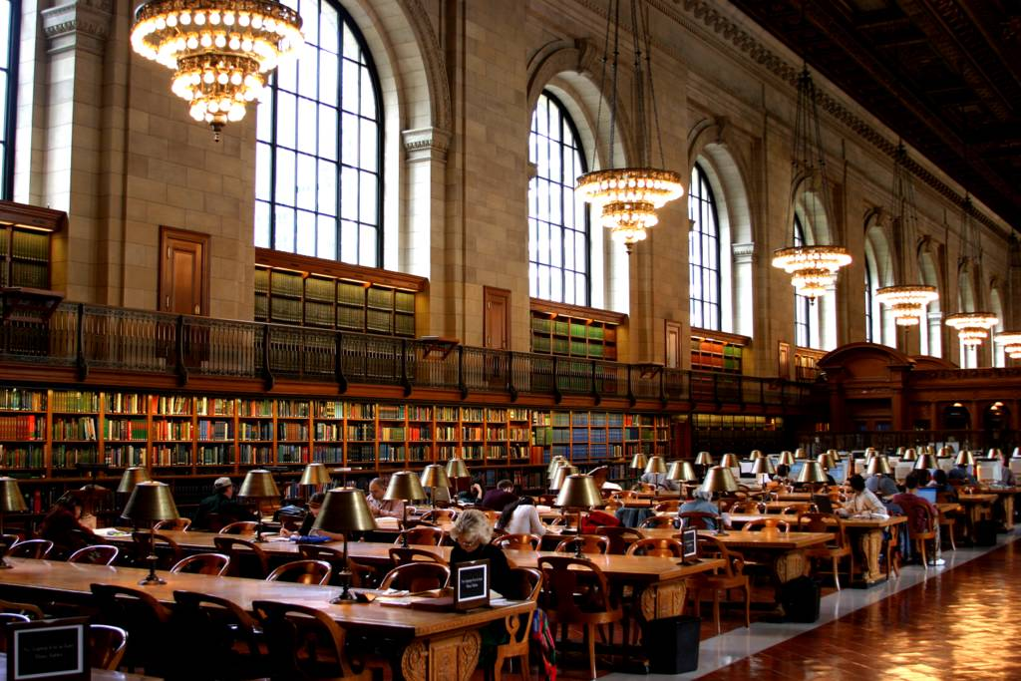
CONCLUSION
The education is far better than before the advent of Islam,
Muslim beware of Islam and choose the right path to follow.
Islam give us new direction to maintain a better life style.
Muslim follow the Education of Islam and differentiate between the right and wrong.
Seek education from CRADLE to GRAVE

